Slide 1
KRCS HR Staff Meeting November 2025

Slide 2
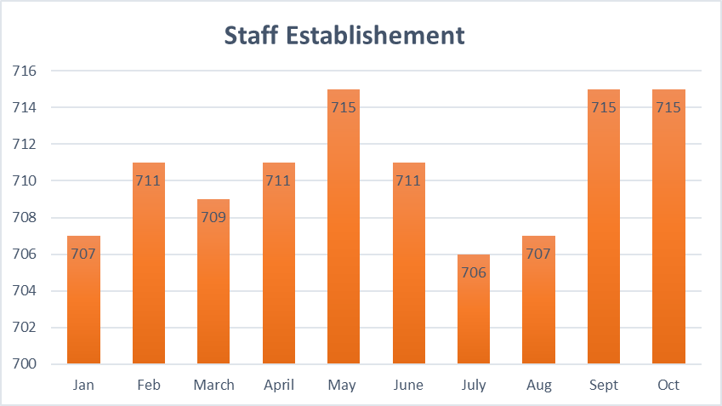
Headcount

Slide 3
Joiners
Evalyne Jepchumba Sang-Business Manager Thread and Ink
Harisson Barmasop-Sales and Marketing Manager-Thread and Ink
Cyrus Ndegwa Gikonyo-Finance Manager-Thread and Ink
Nickson Okeyo Machogu-Intern-ICT
Isaac Gitau Mwangi-Record and Resource Center Officer-KRCTI

Slide 4
Leavers
Lydia Jeptoo Chebii-Project Officer-SRR
Habon Ali Hubiya-Nursing Officer-KRO
Richard Otieno Aguko-Driver-HQ
James Wabwile Nyanga-Data Management Officer-GF

Slide 5
HR Pointers
As we approach the end of the year, we request that staff utilize their annual leave days to avoid December coverage issues – Supervisors and Sector heads should strictly implement and plan leave in their respective docket. No carry over days.
All staff appraisals are due by 28th November 2025 , staff are reminded to approach their line managers to bring this to a close and submit appraisals before 28th November 2025.
The short rains have started staff and volunteers are reminded to:
Take caution of flooded places and roads.
Attend all briefs and MPHSS support given while responding.
Take time to rest and take breaks during intense response.
In case of any emergency reach out to your immediate supervisor.
Take note of the weather forecast shared by the ICHA team on the various platforms.

Slide 6
Thank
You

